Slide 1
CODES AND OUTPUTS

Slide 2
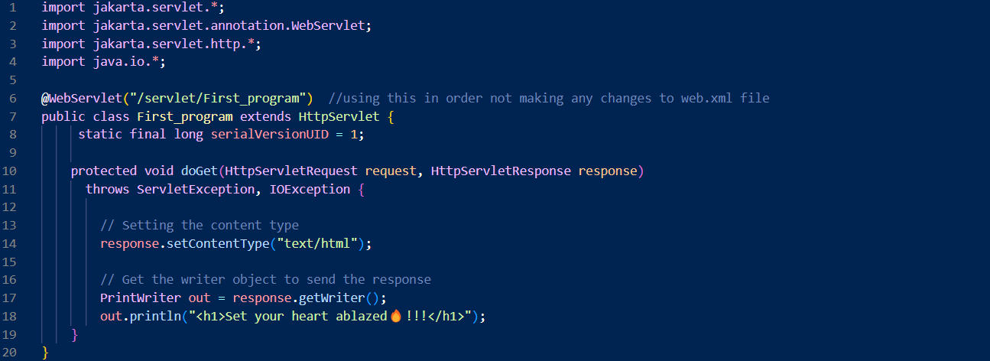
First_Program.java

Slide 3
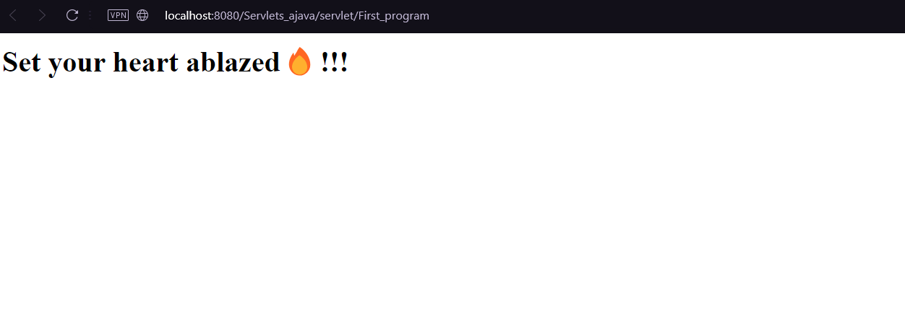
First_Program.java (Output)

Slide 4
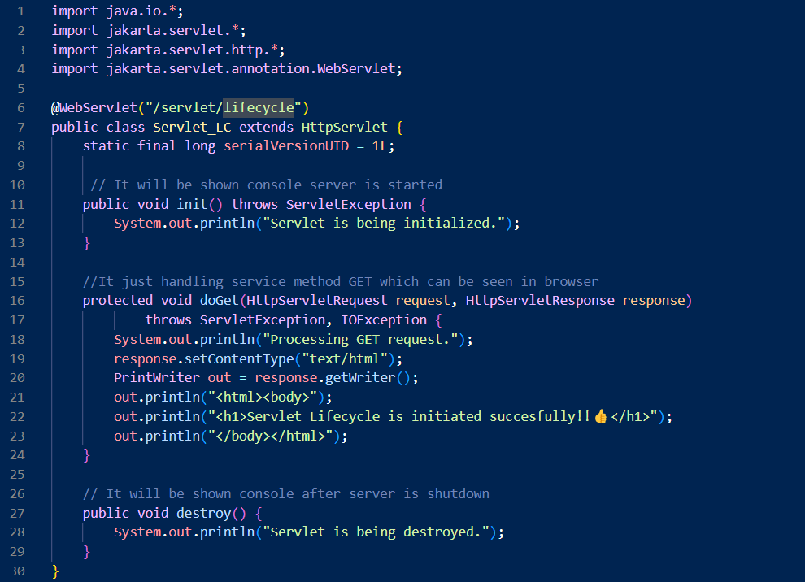
Servlet_LC.java

Slide 5
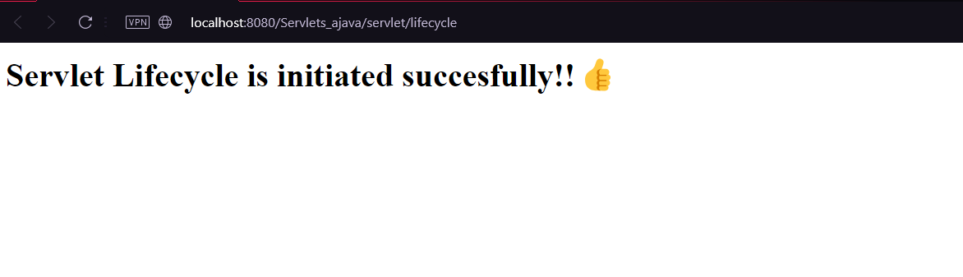
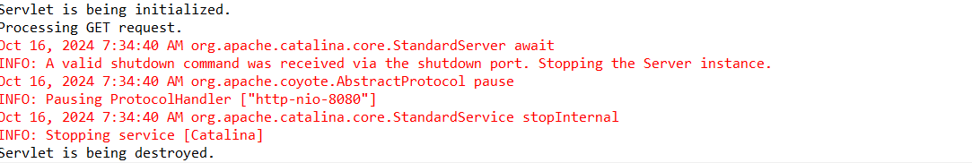
Servlet_LC.java(Output)
Browser output
Console output after creating and destroying servlet

Slide 6
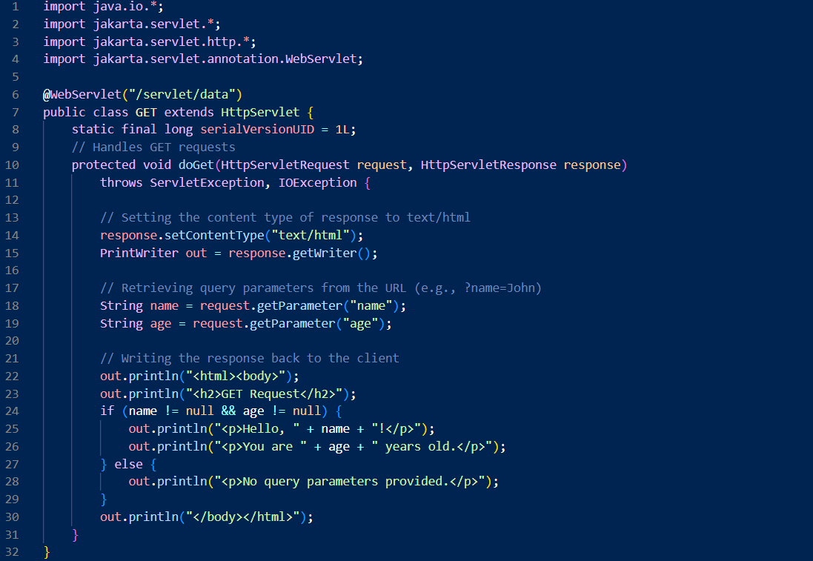
GET.java

Slide 7
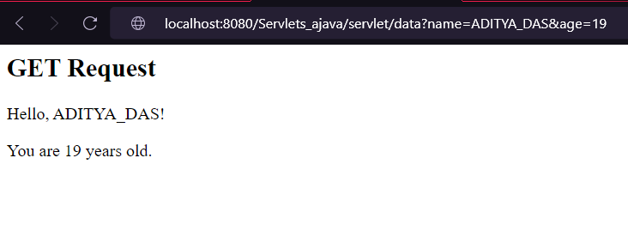
GET.java (Output)

Slide 8
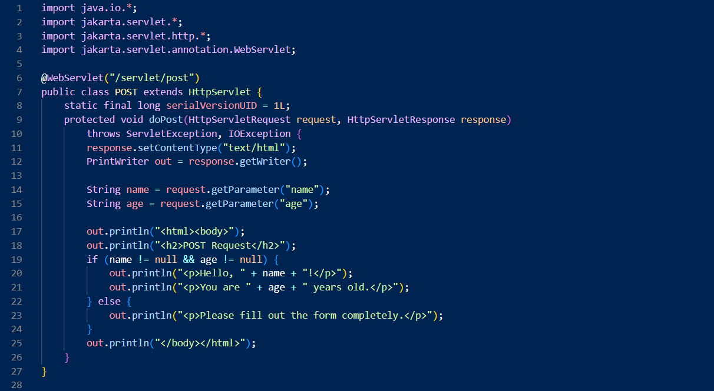
POST.java

Slide 9
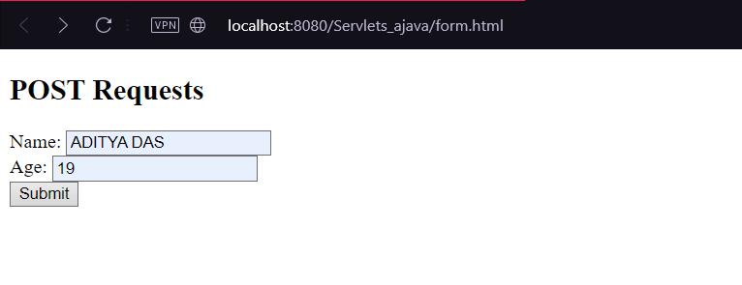
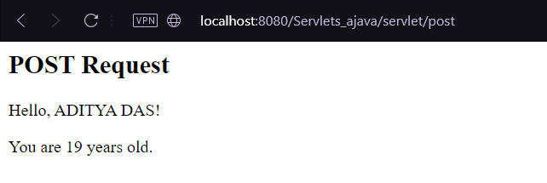
POST.java (output)

Slide 10
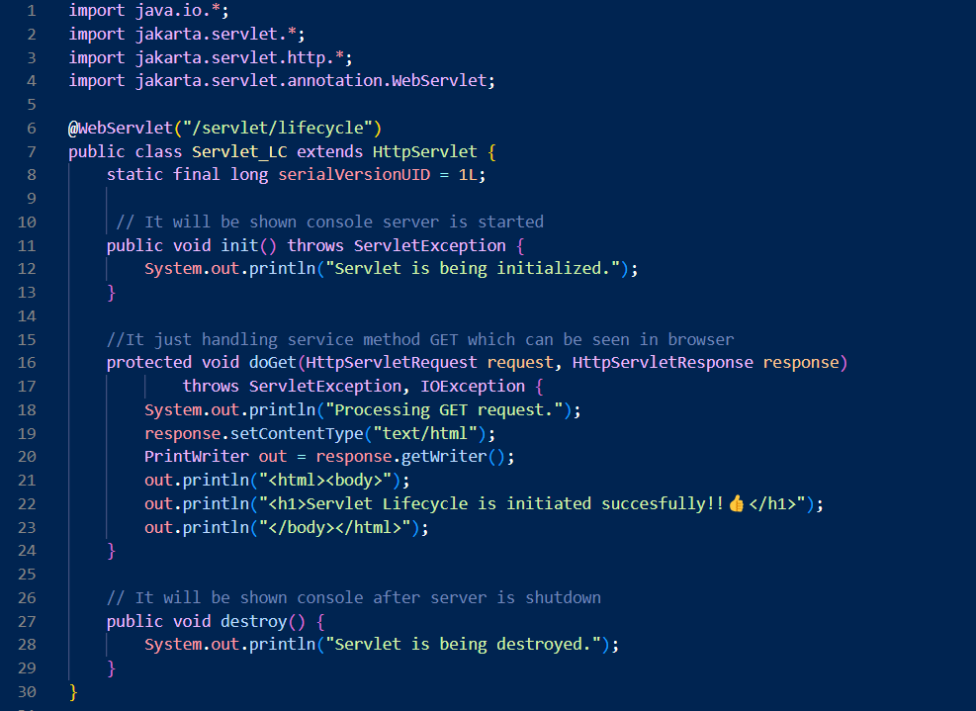
Servlet_LC.java

Slide 11
Servlet_LC.java (Output)

Slide 12
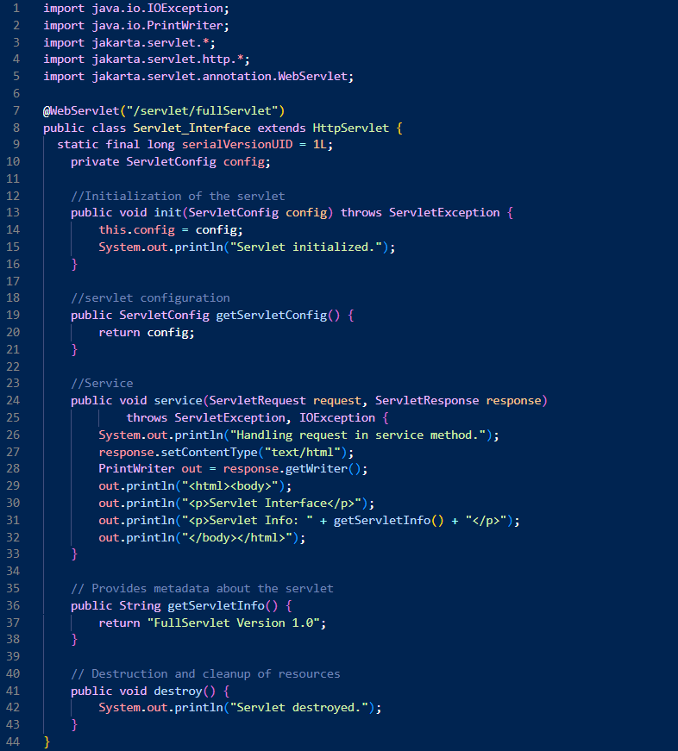
Servlet_Interface.java

Slide 13
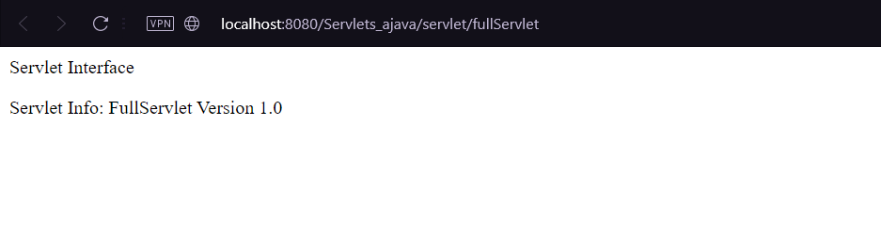
Servlet_Interface.java (output)

Slide 14
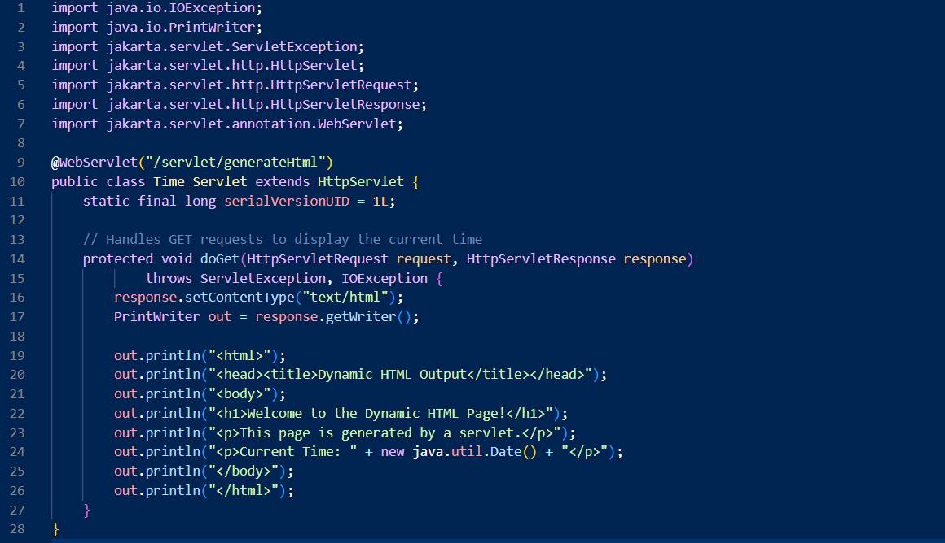
Time_Servlet.java

Slide 15
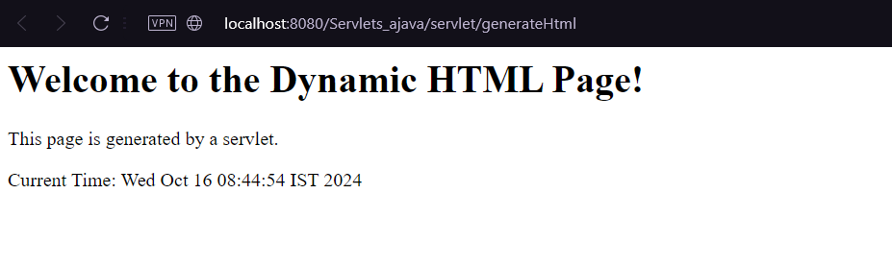
Time_Servlet.java (Output)

Slide 16
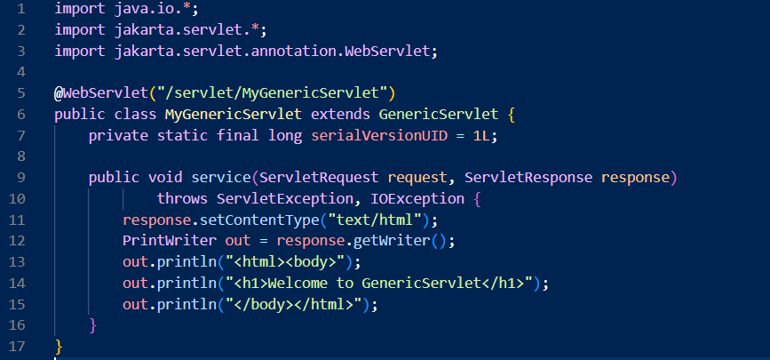
MyGenericServlet.java

Slide 17

MyGenericServlet.java (output)

Slide 18
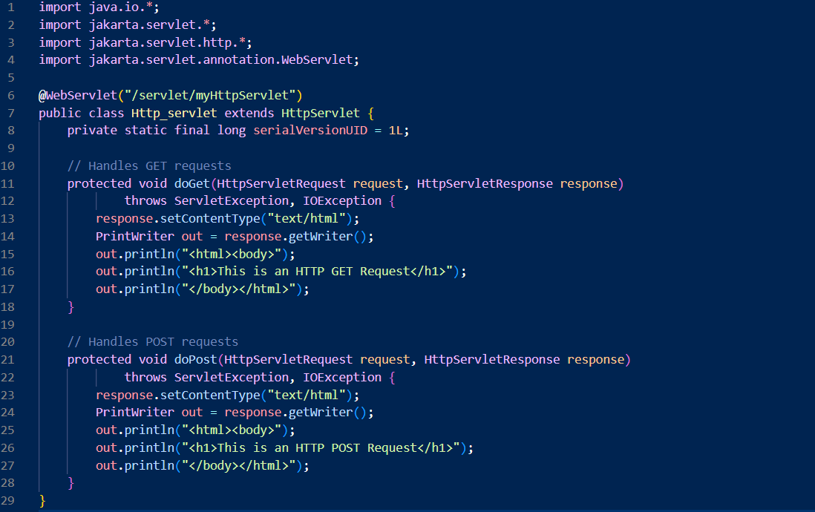
Http_servlet.java

Slide 19
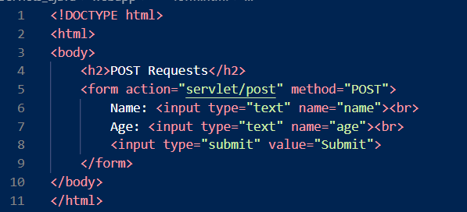
Form.html

Slide 20
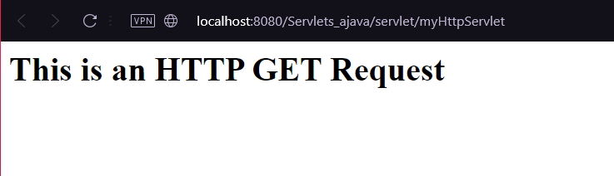
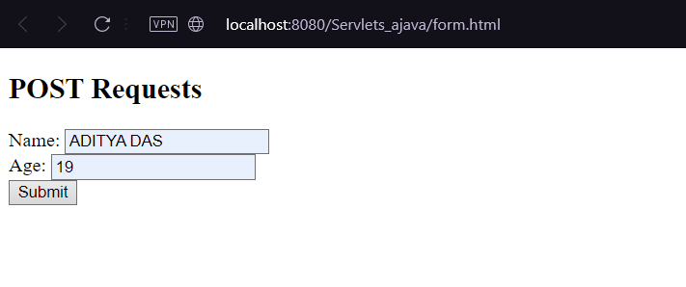
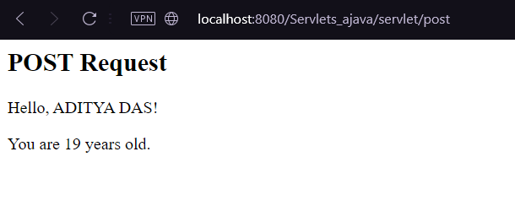
Http_servlet.java and form.html (output)
Without using form.html
Using form.html

Slide 21
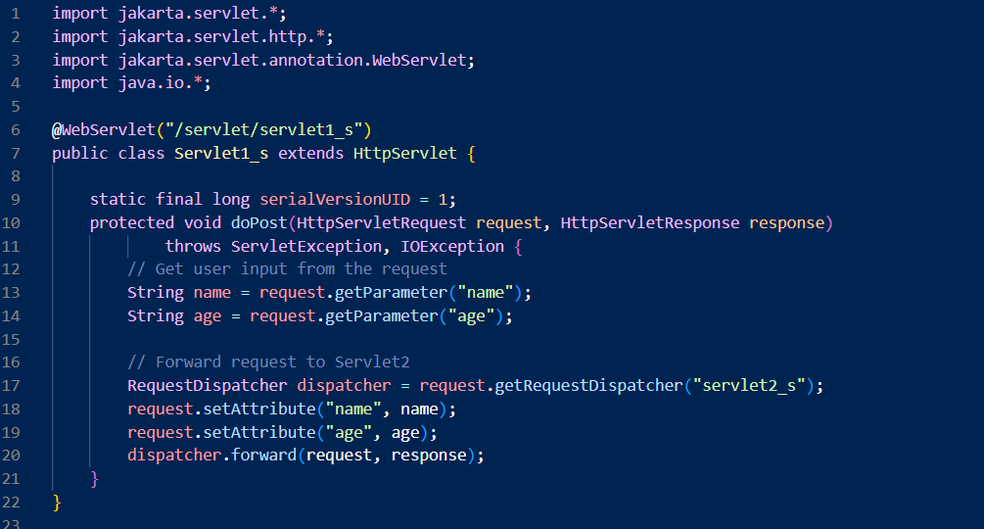
Servlet1_s.java

Slide 22
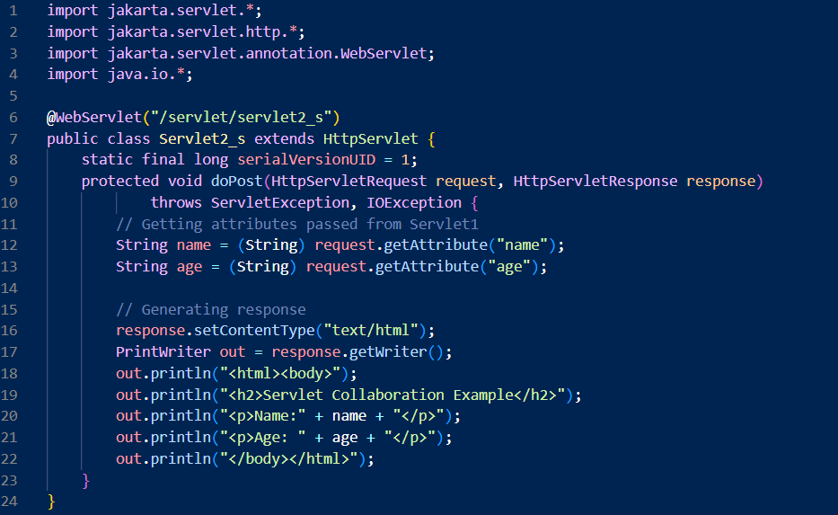
Servlet2_s.java

Slide 23
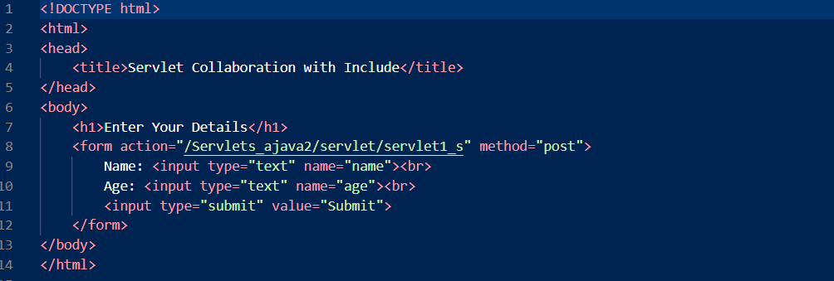
RD1.html

Slide 24
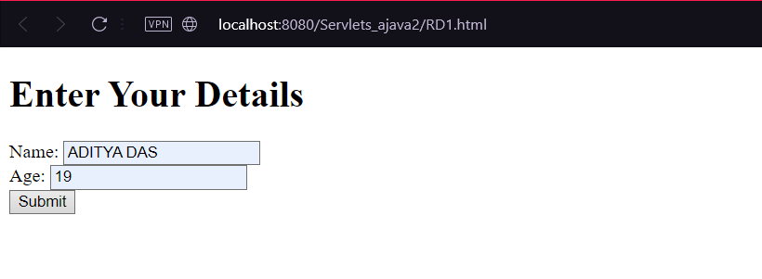
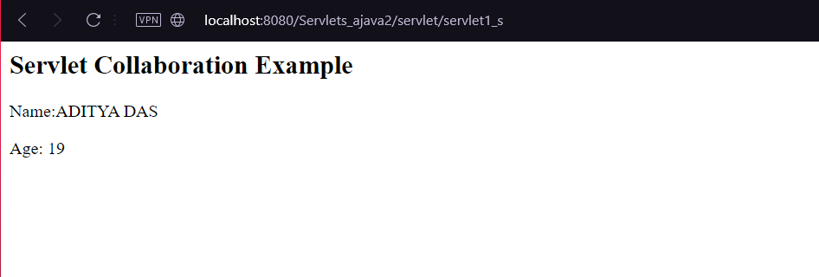
Servlet1_s.java,Servlet2_s.java,RD1.html (output)

Slide 25
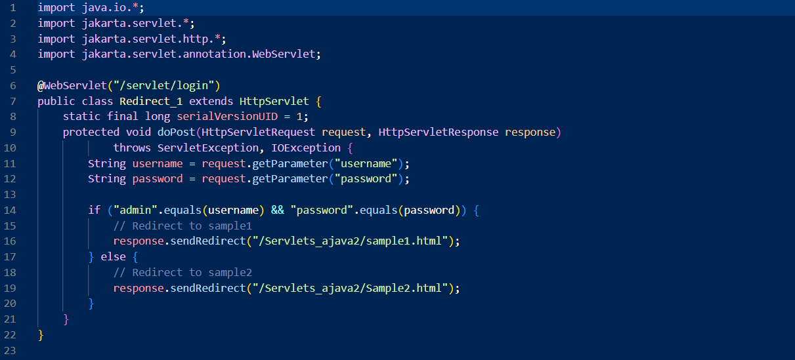
Redirect_1.java

Slide 26
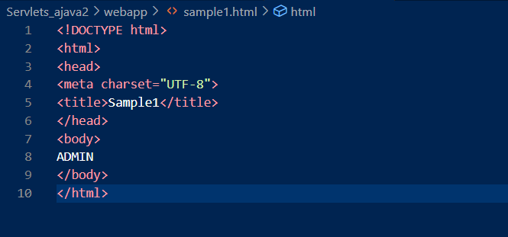
sample.html

Slide 27
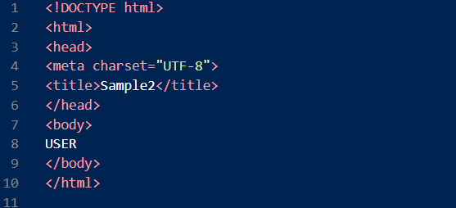
Sample2.html

Slide 28
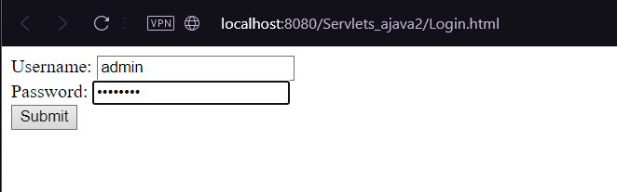

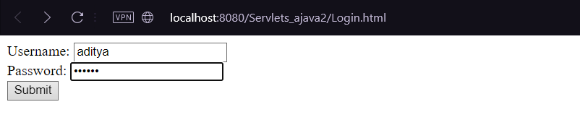

Redirect_1.java,sample1.html,sample2.html (output)
Output 1:-
Output 2:-

Slide 29
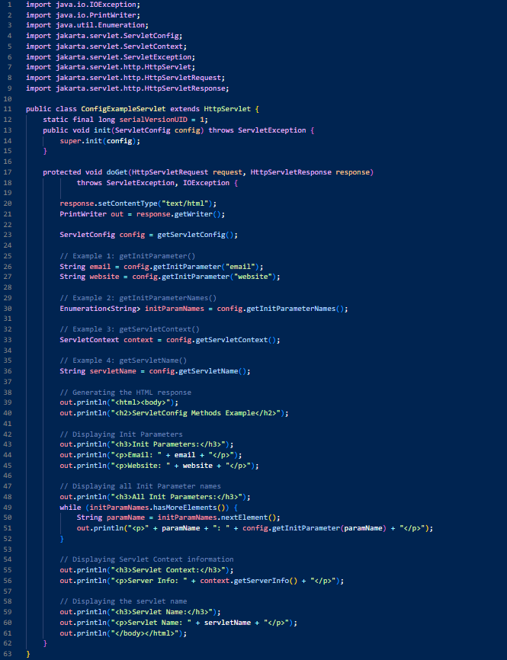
ConfigExampleServlet.java

Slide 30
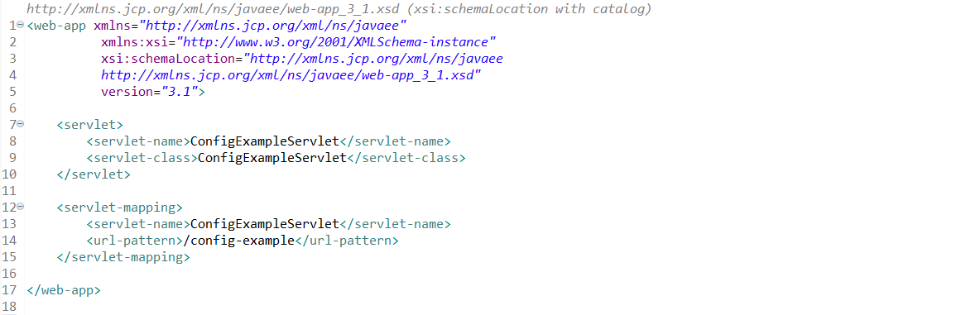
Web.xml

Slide 31
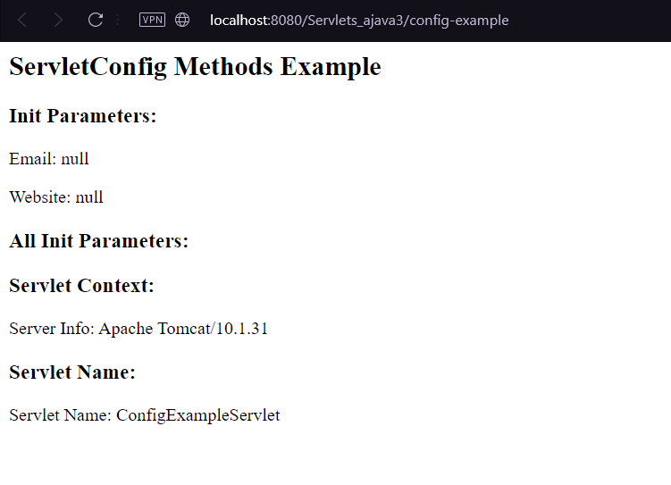
ConfigExampleServlet.java and web.xml (output)

Slide 32
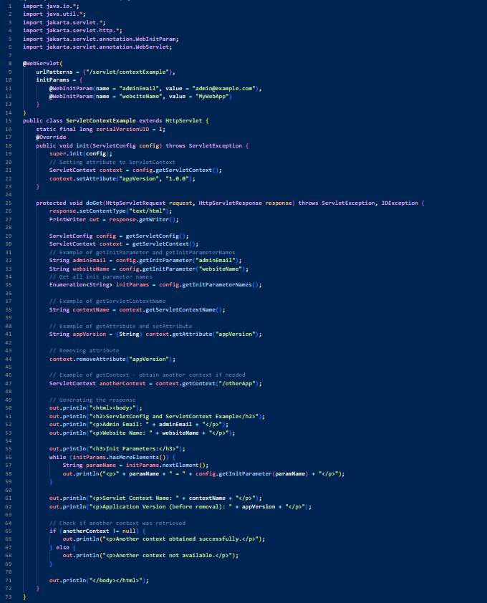
ServletContextExample.java

Slide 33
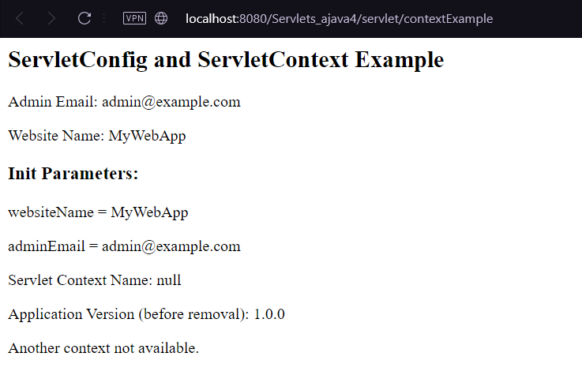
ServletContextExample.java (Output)

Slide 34
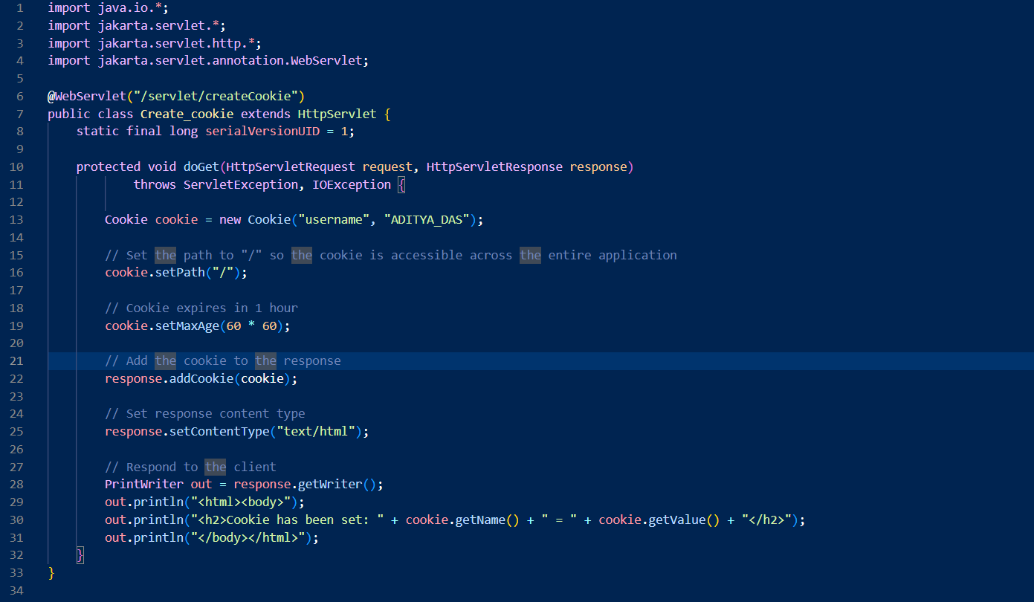
Create_cookie.java

Slide 35
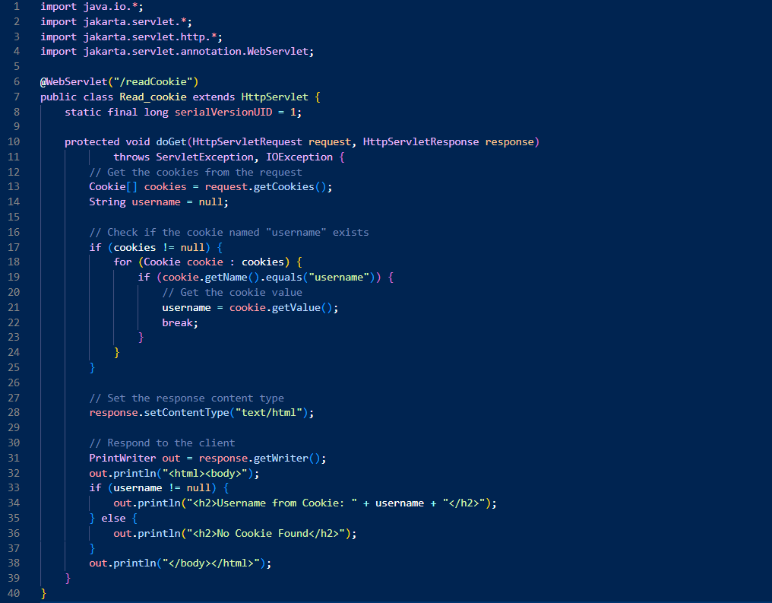
Read_cookie.java

Slide 36

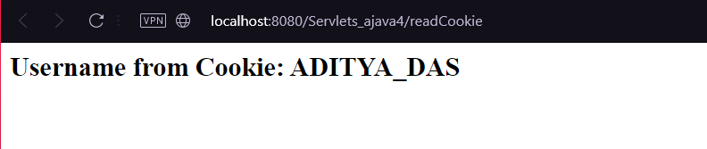
Create_Cookie,Read_cookie.java (output)

Slide 37
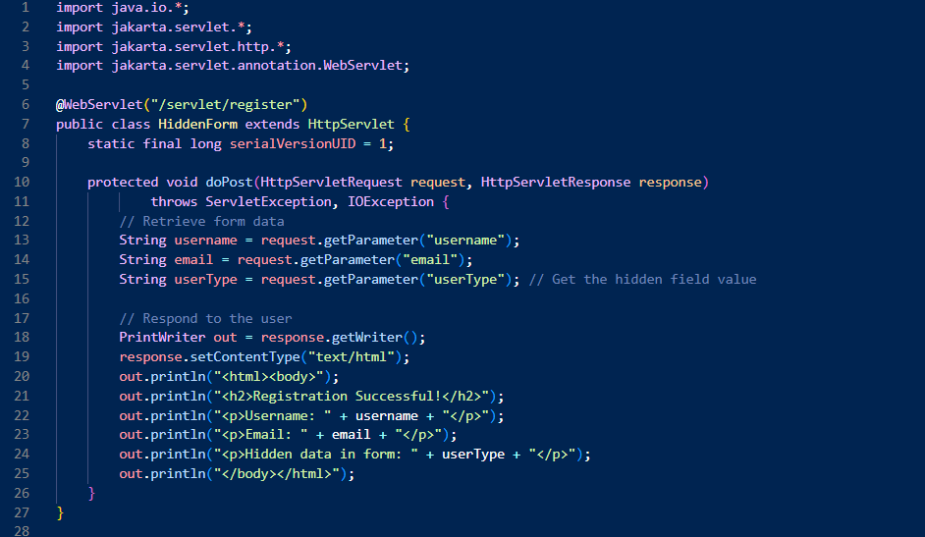
HiddenForm.java

Slide 38
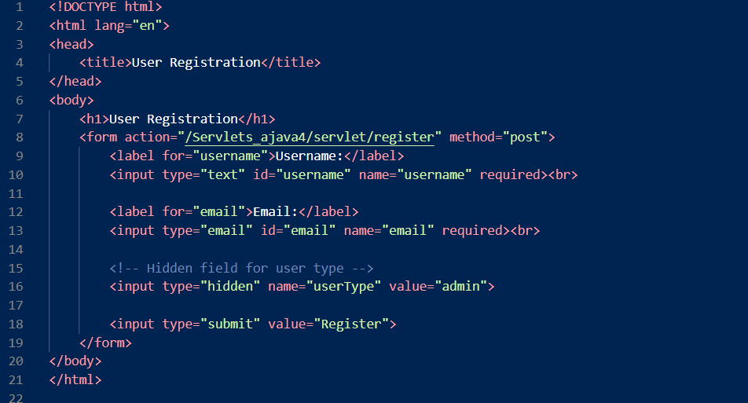
HTML_Hidden_form.html

Slide 39
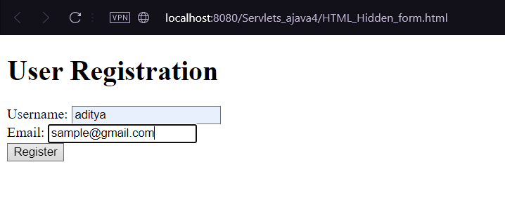
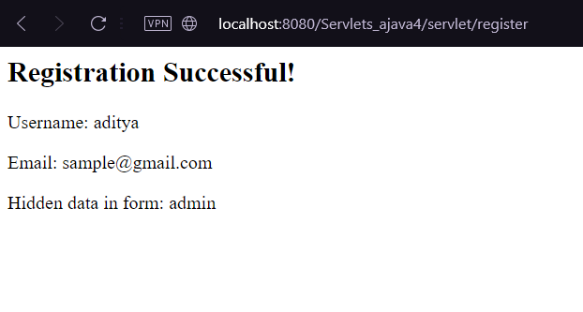
HiddenForm.java,HTML_Hidden_form.html (output)

Slide 40
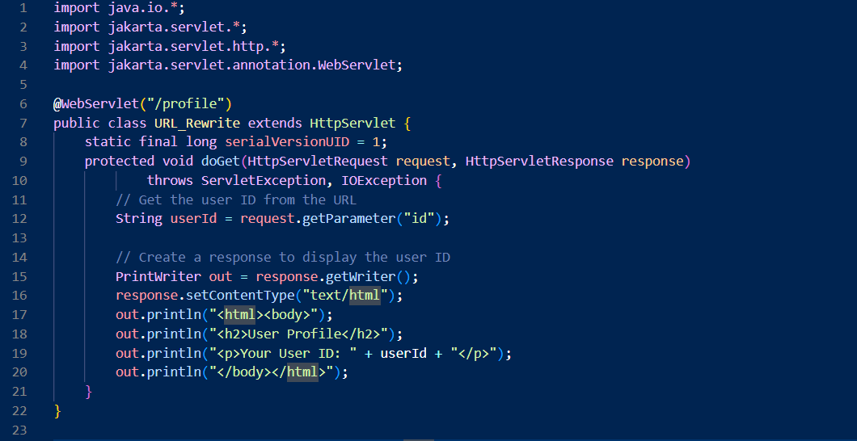
URL_Rewrite.java

Slide 41
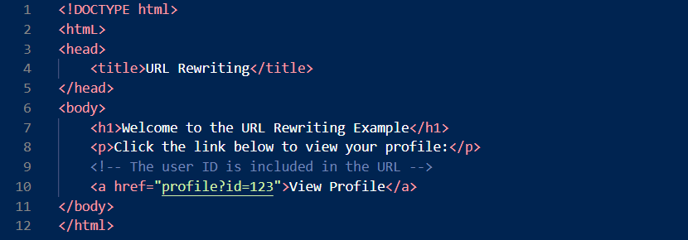
url_rewrite.html

Slide 42
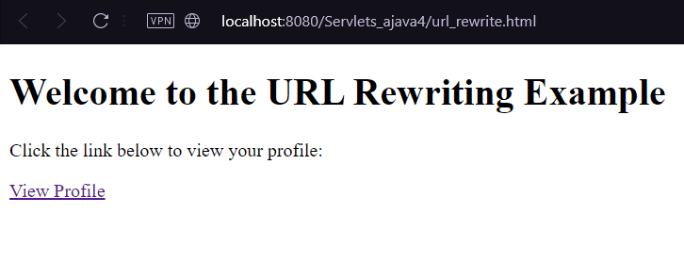
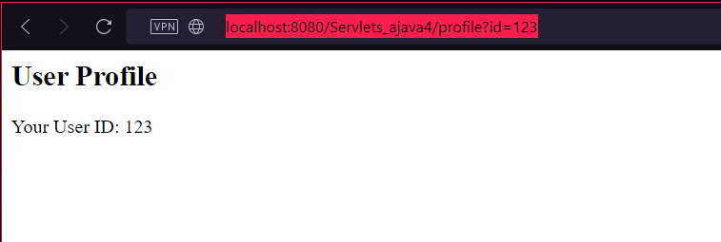
URL_Rewrite.java, url_rewrite.html (output)

Slide 43
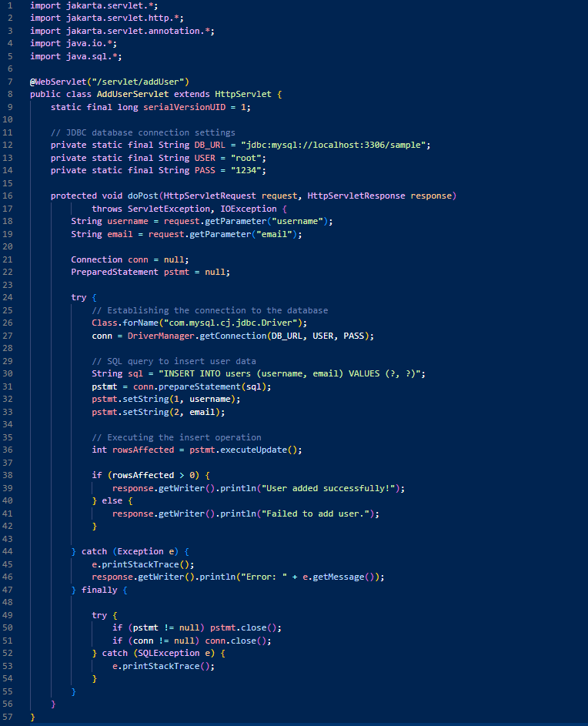
AddUserServlet.java

Slide 44
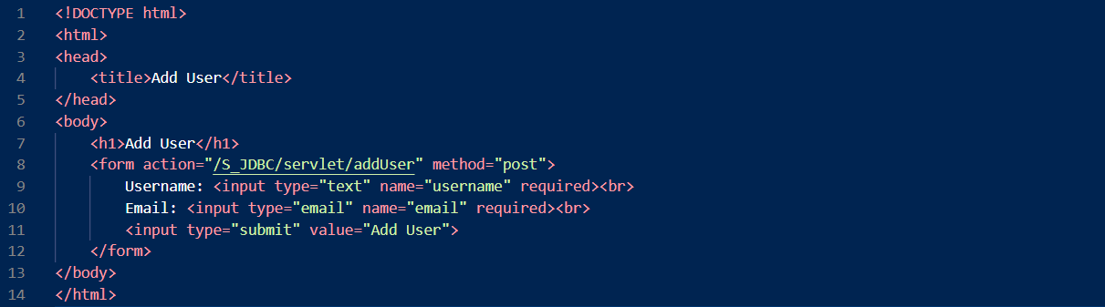
addUser.html

Slide 45
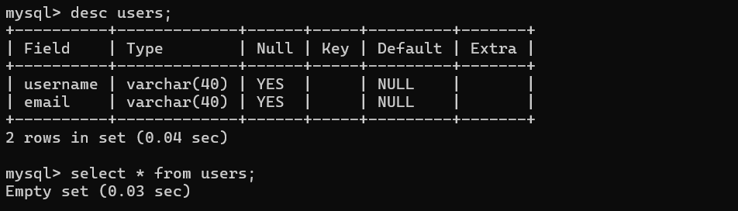



AddUserServlet.java,addUser.html and mysql(output)

